Slide 1

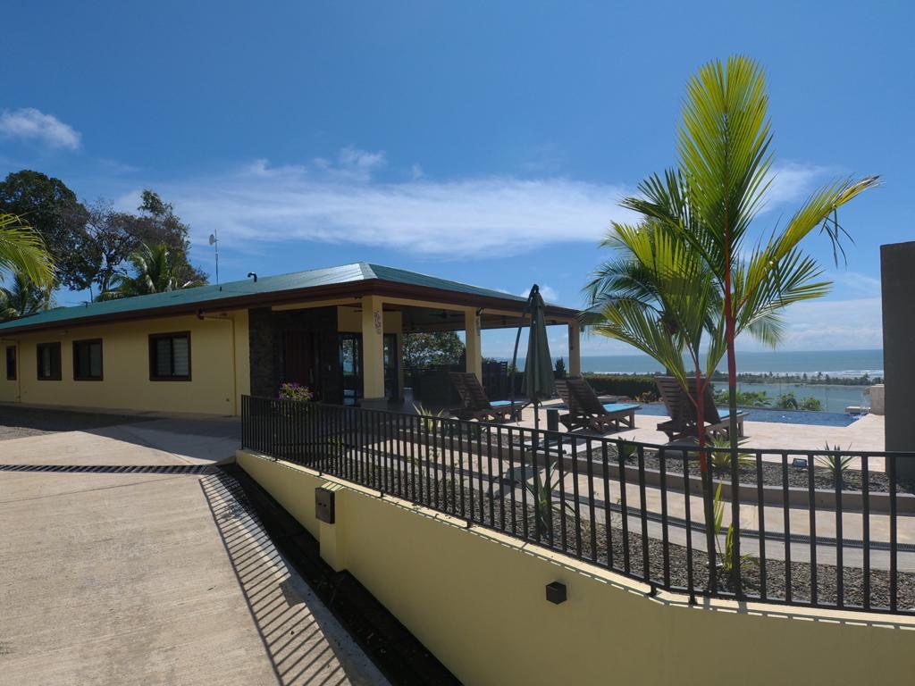
Florida vacation homes for rent

Slide 2
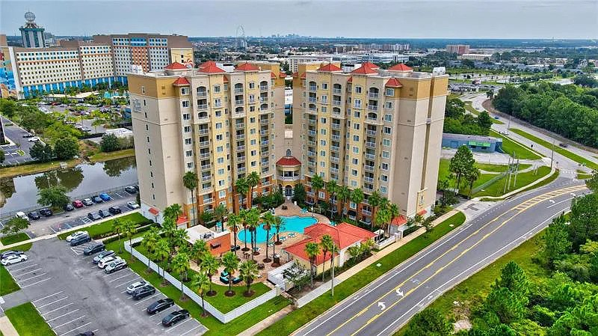
Stay in the top-rated vacation accommodations in Orlando, Florida. Rads Vacation Rentals Company offers a wide range of luxury vacation homes. Find serenity and adventure in one place and enjoy a unique vacation experience. Book the Florida vacation homes for rent and enjoy the luxuries everywhere in the home.
https://www.radsvacationrentals.com

Slide 3
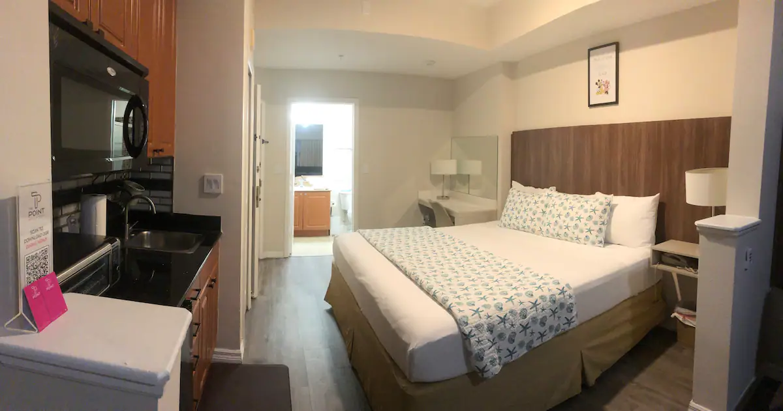
The accommodations feature multiple common areas for the guests. There is a dining table in the living room where a dining table, sofa, closet, and large screen TV are available for entertainment and relaxation. Get family vacation homes Orlando FL, and spend your next vacation at your own pace. Check the prices and availability of the vacation rentals based on your vacation dates and make it yours today.

Slide 4
Contact Information
Website:-
https://www.radsvacationrentals.com
Email:-
rohanl1@yahoo.com
Phone No:-
+1-917-676-7892

Slide 5
Thank
For
Watching

